Slide 1
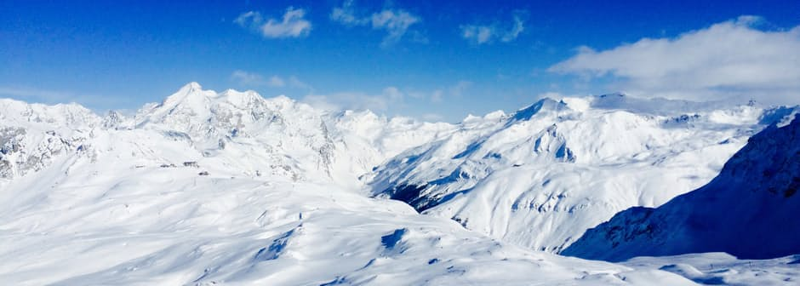
Interpretation of snow properties from imaging spectrometry

Slide 2
Overview
Fundamental concept of Snow microphysics
Key concept of Imaging spectrometry
Relate Physical properties to Image retrievals
Current accomplishments
Future scope

Slide 3
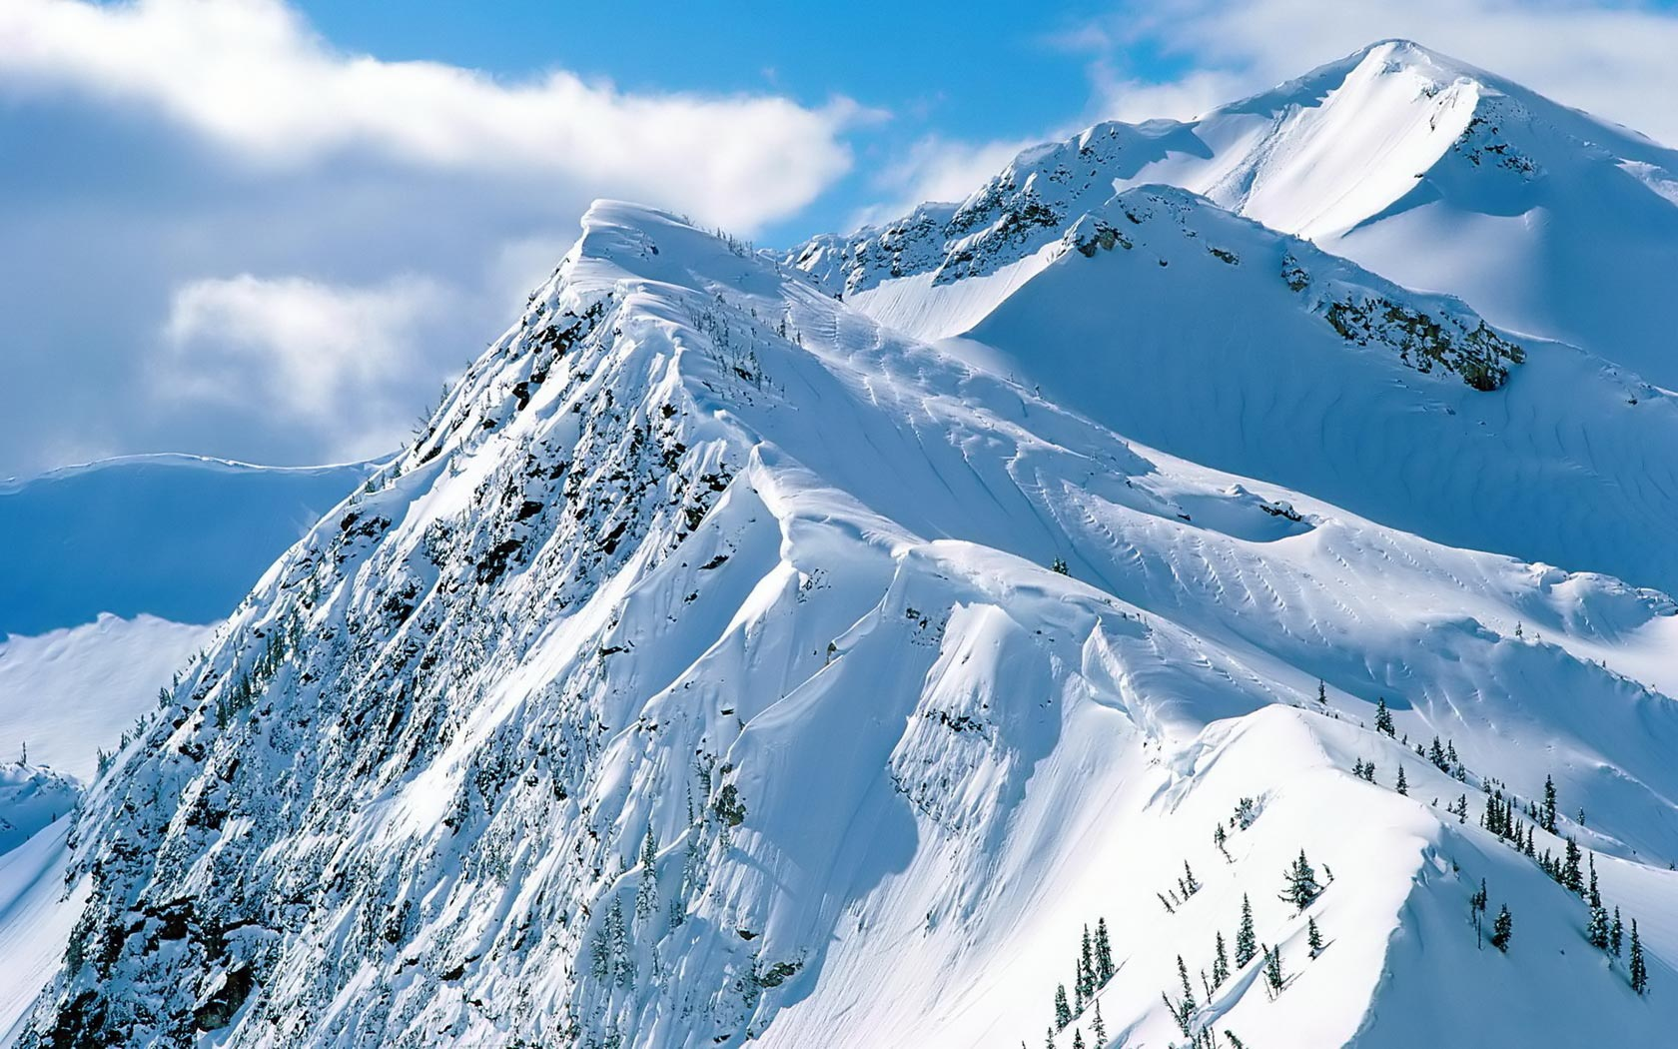
Overview
HOW
WHAT
WHY

Slide 4
Definition of Imaging Spectrometry
Simultaneous acquisition of spatially co-registered images, in many narrow, spectrally contiguous bands, measured in calibrated radiance units from a remotely operated Platform.(Scheapman, 2007)
Voilà! In view, a humble vaudevillian veteran, cast vicariously as both victim and villain by the vicissitudes of Fate. This visage, no mere veneer of vanity, is a vestige of the vox populi, now vacant, vanished…........

Slide 5
Gamma Rays
X rays
Ultra-violet(UV)
Visible (400 - 700nm)
Near Infrared (NIR)
Infrared (IR)
Microwaves
Weather radar
Television, FM radio
Short wave radio
Revisit theory
Electro Magnetic Spectrum
10⁻¹nm 1 nm 10⁻²μm 10⁻¹μm 1 μm 10 μm 100 μm 1 mm 1 cm 10 cm 1 m 10²m
Violet
Blue
Green
Yellow
Orange
Red

Slide 6
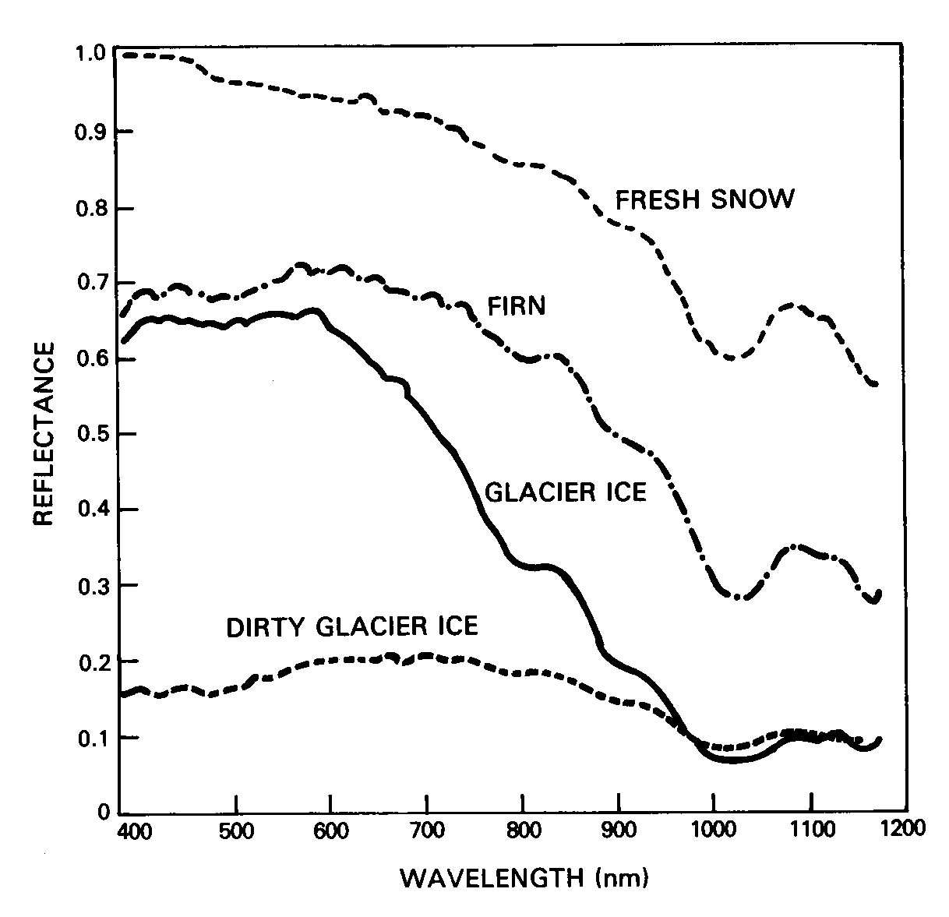
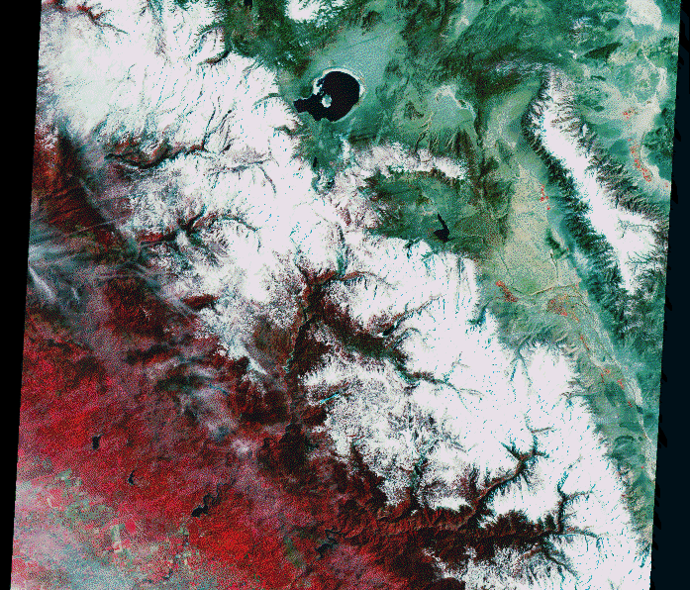
HOW
WHAT
WHAT

Slide 7
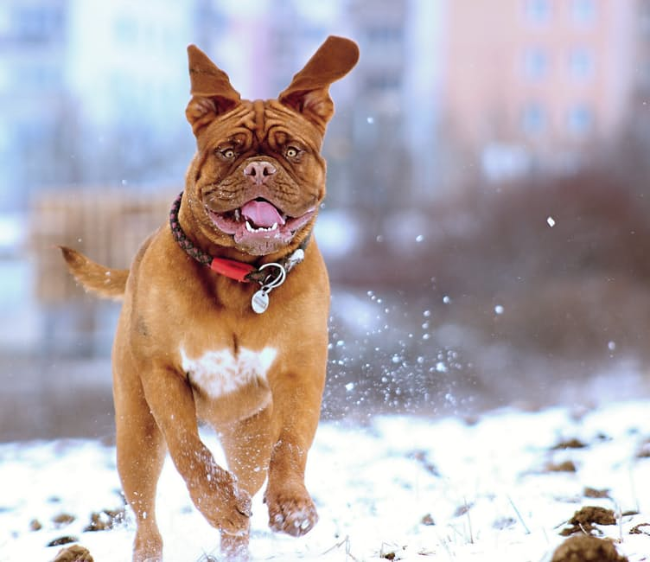
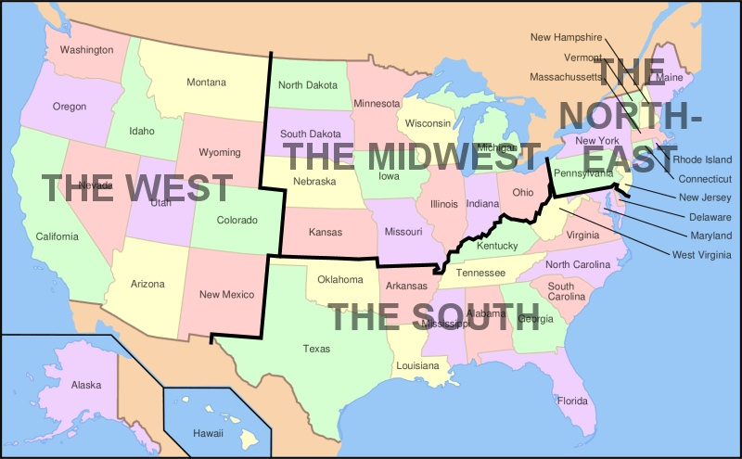
Why on Snow
70 % of Annual streamflow provided by snow melt
Impact water supply, irrigation and hydro electric power generation
Provide water manager Near real time observation.
Forecast timing and amount of spring and summer run off

Slide 8
Snow Albedo
Method for retrieving surface albedo from satellite remote sensing data.
Steps | Output Values
1. apply cloud-mask | cloud-free pixels (DN)
2. calibration | DN radiance (W·m⁻²·sr⁻¹)
3. atmospheric corrections | radiance reflectance
4. anisotropic correction | reflectance narrowband albedo
5. narrowband-to-broadband (NTB) conversion | narrowband albedo broadband albedo
<https://www.youtube.com/watch?v=WgjTO6CNwzM>
Maurer et al., Retrieval of surface albedo from space, 2002

Slide 9
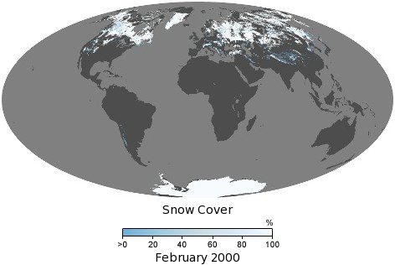
Snow Cover Area (SCA)
Courtesy: NASA

Slide 10
Normalize Difference Snow Index (NDSI)
500m Band Number | Wavelength (nm) | Color
Sur_refl_b01 | 0.620- 0.670 | Red
Sur_refl_b02 | 0.841- 0.876 | NIR
Sur_refl_b03 | 0.459- 0.479 | Blue
Sur_refl_b04 | 0.545- 0.565 | Green
Sur_refl_b05 | 1.230- 1.250 | NIR
Sur_refl_b06 | 1.628- 1.652 | MIR
Sur_refl_b07 | 2.105- 2.155 | MIR
NDSI= (band 4 – band 6)/
( band 4 + band 6)
0.4: Magic Number!?

Slide 11
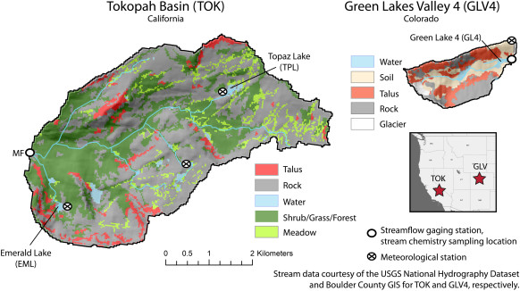

Slide 12
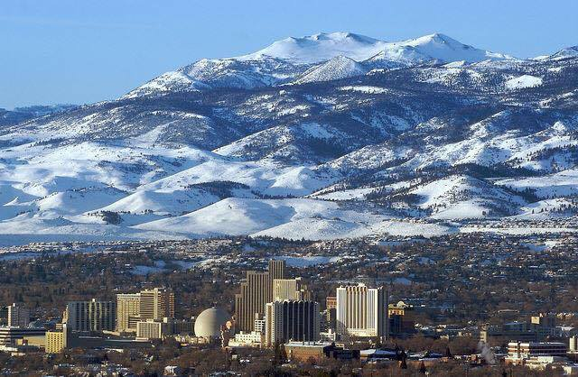
Spectral Mixture Analysis
Radiance measured at the sensor is linear combination of radiances reflected from individual surfaces ( Rock, Vegetation as end members)
Fractional Snow Cover Area

Slide 13
Distinguish characteristics spectra

Slide 14
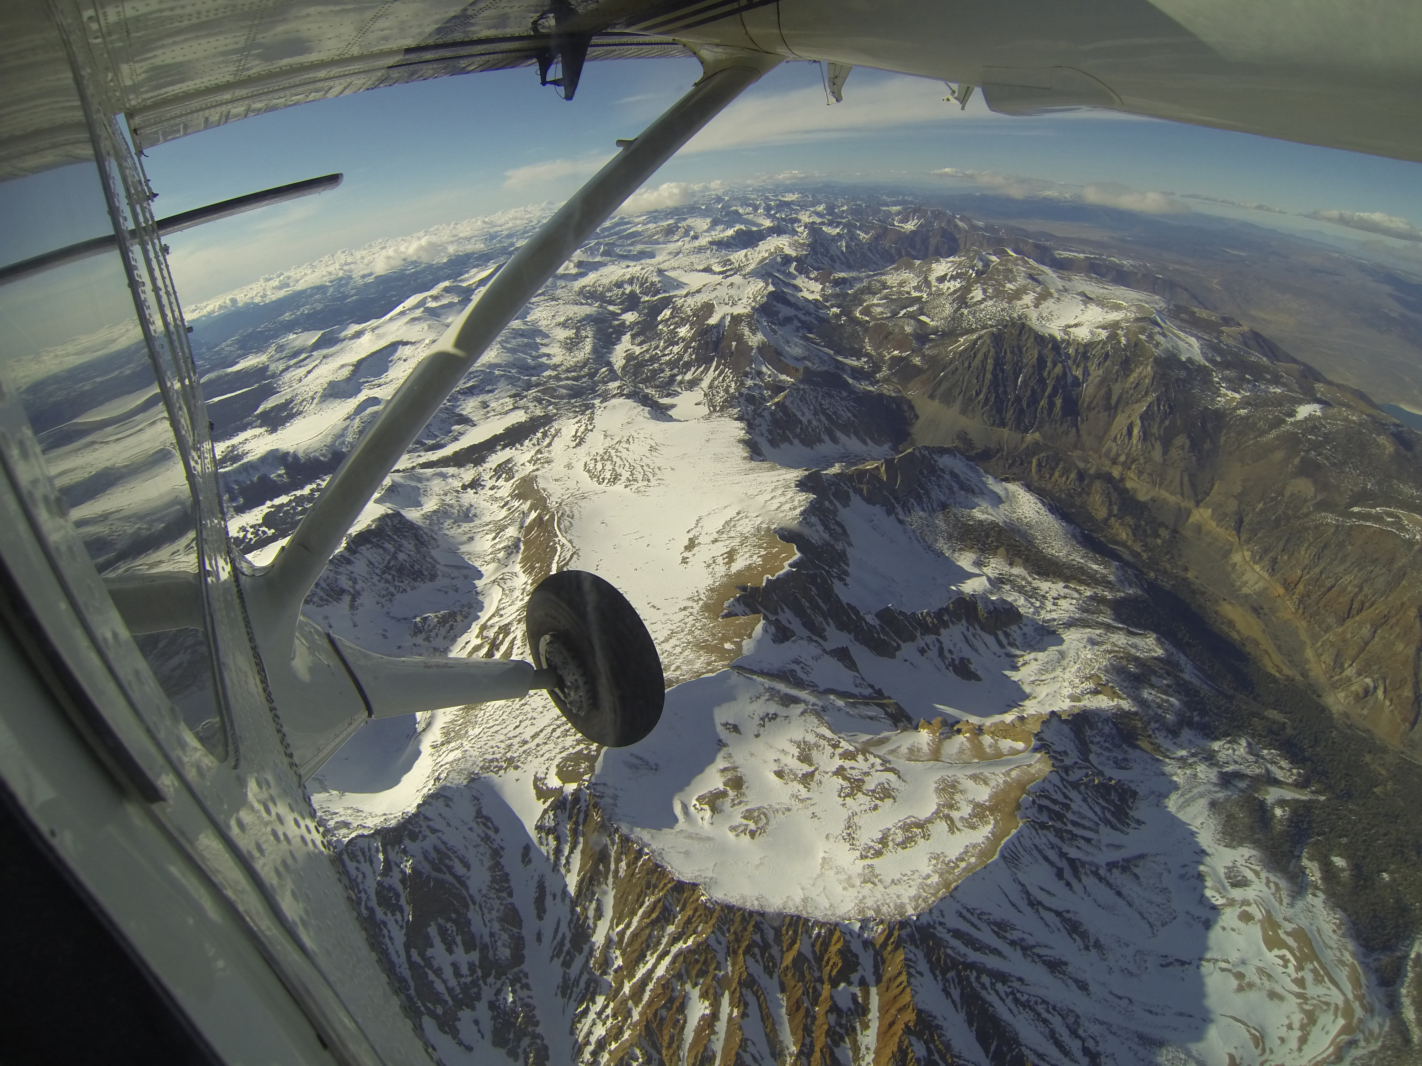
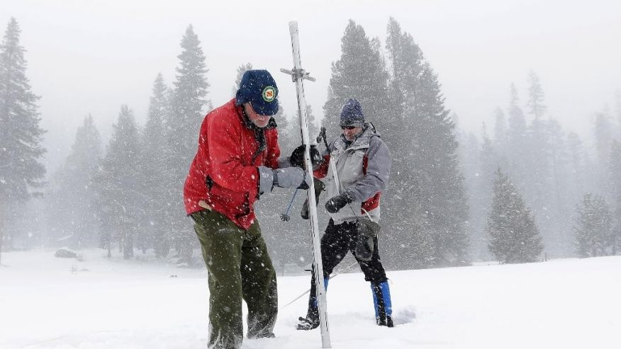
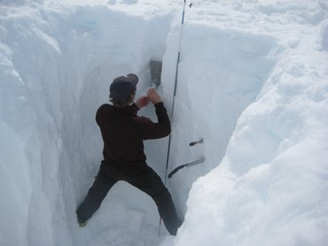
Snow Water Equivalent (SWE)
SWE (kg/m2) = snow depth (m) x snow density (kg/m3)

Slide 15
Physics of Pure Snow

Slide 16
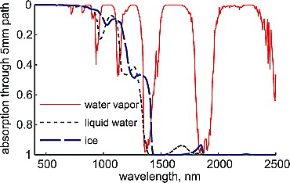
Effect of liquid water
Absorption spectra of water vapor, liquid water, and ice from 400 to 2500 nm at 10-nm spectral resolution. The spectrum for water vapor is for a path through an atmosphere with 5-mm perceptible water. For liquid water and ice the spectrum is calculated for a 5-mm path.
Notes:
Absorption spectra of water vapor, liquid water, and ice from 400 to 2500 nm at 10‐nm spectral resolution. The spectrum for water vapor is for a path through an atmosphere with 5‐mm precipitable water. For liquid water and ice the spectrum is calculated for a 5‐mm path.
IF THIS IMAGE HAS BEEN PROVIDED BY OR IS OWNED BY A THIRD PARTY, AS INDICATED IN THE CAPTION LINE, THEN FURTHER PERMISSION MAY BE NEEDED BEFORE ANY FURTHER USE. PLEASE CONTACT WILEY'S PERMISSIONS DEPARTMENT ON PERMISSIONS@WILEY.COM OR USE THE RIGHTSLINK SERVICE BY CLICKING ON THE 'REQUEST PERMISSIONS' LINK ACCOMPANYING THIS ARTICLE. WILEY OR AUTHOR OWNED IMAGES MAY BE USED FOR NON-COMMERCIAL PURPOSES, SUBJECT TO PROPER CITATION OF THE ARTICLE, AUTHOR, AND PUBLISHER.

Slide 17
Effect of grain size

Slide 18
Effect of grain size

Slide 19
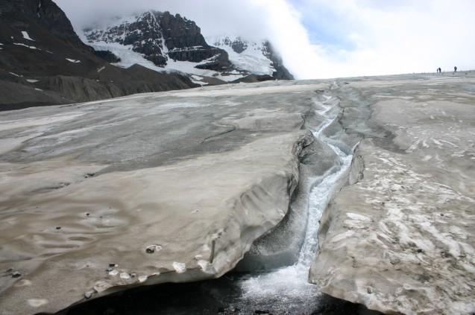
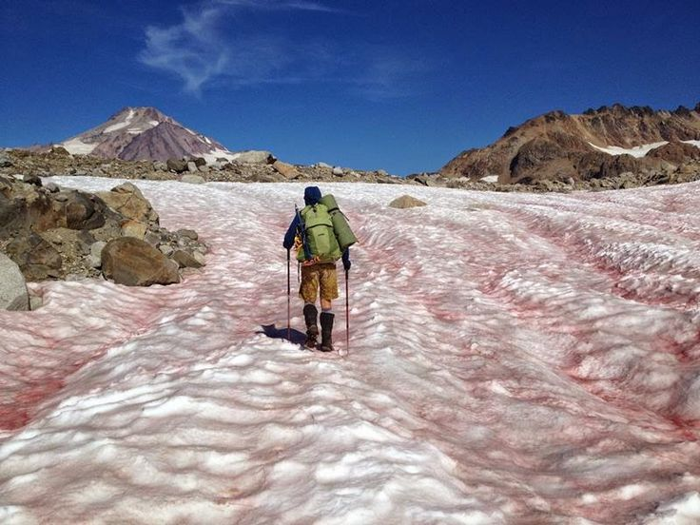
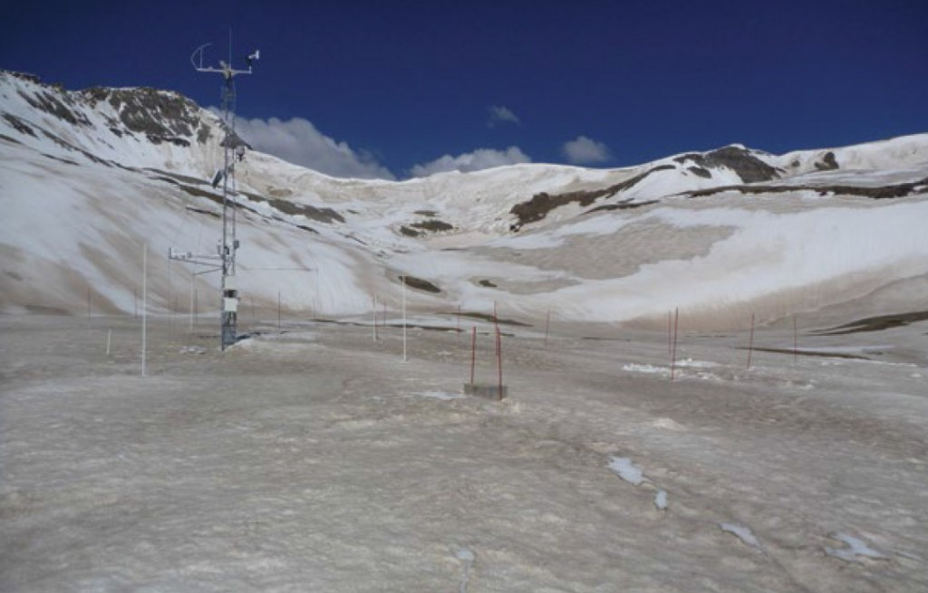
Impurities on Snow

Slide 20
The order of magnitude differences for m_{i} in Soot and Pure Snow
Solid lines are imaginary part of refractive index
Effects of snow physical parameters on spectral albedo and bidirectional reflectance of snow surface, Akoi et al., 2000)

Slide 21
Reflectance with Impurities on Snow

Slide 22
Computation of Bidirectional Reflectance Distribution Function
Tanikawa et al., 2002Remote sensing of snow grain-size and impurities using snow BRDF model

Slide 23
Accommodate Multiple Scattering
(1)
(2)
(3)
(4)
(5)
(6)
Soil
Snow
Monte Carlo Method

Slide 24
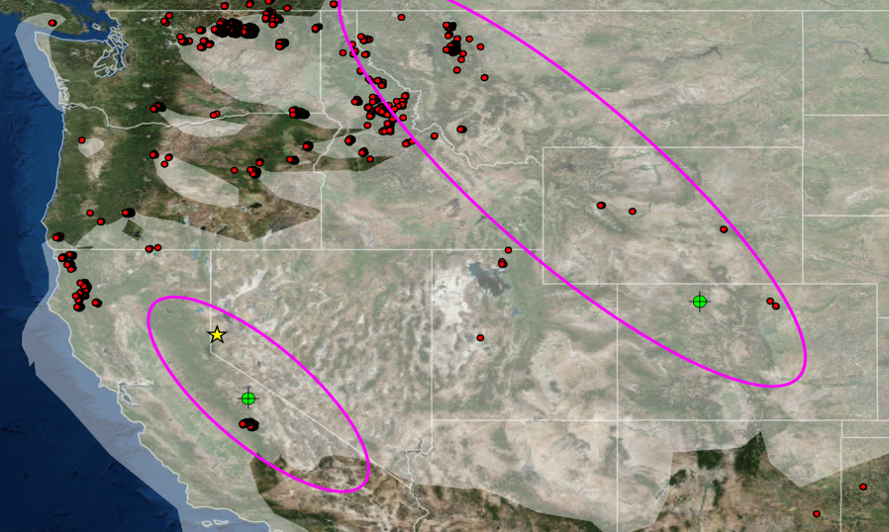
Can Transported Smoke plume from Wildfire Reduce Snow albedo

Slide 25
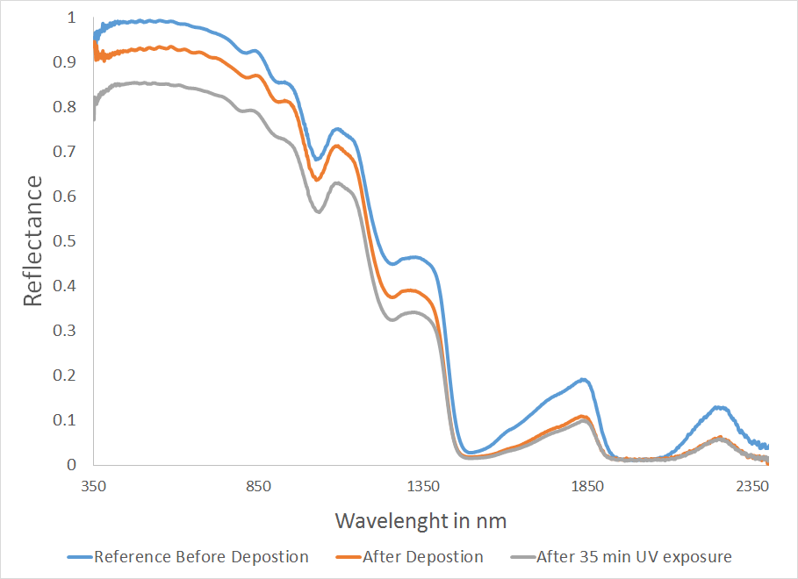
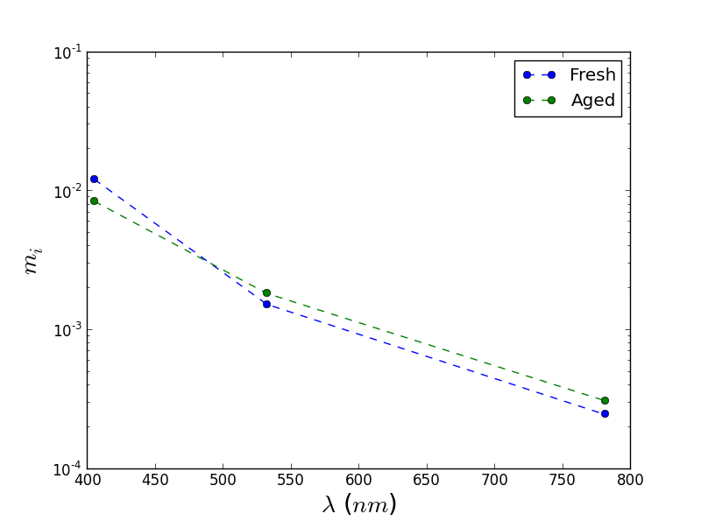
Preliminary Data
Complex Refractive index of Siberian Peat. ( Source: Patricio)
Suwanee River Fulvic Acid Deposition

Slide 26
Future Scope
Variability of snow grain size with depth: Discrepancy and further Exploration
Exploring angular effects: On the way to Spectro-directional remote Sensing
Spectro temporal combination to monitor fast change
Extend to skills and techniques to Mars
Updating the results from imaging spectrometer to Hydroclimate model more Frequently

Slide 27
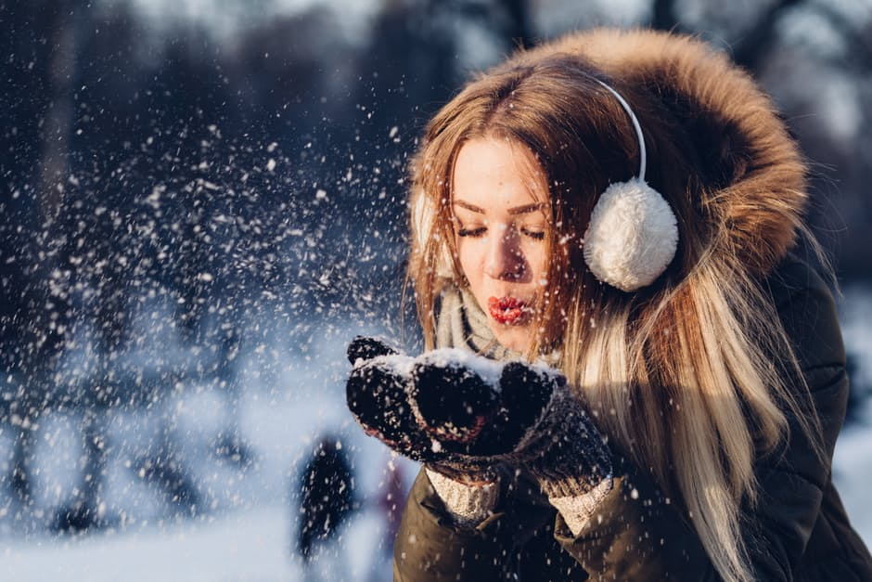
Thank You

Slide 28
Questions?

